Slide 1
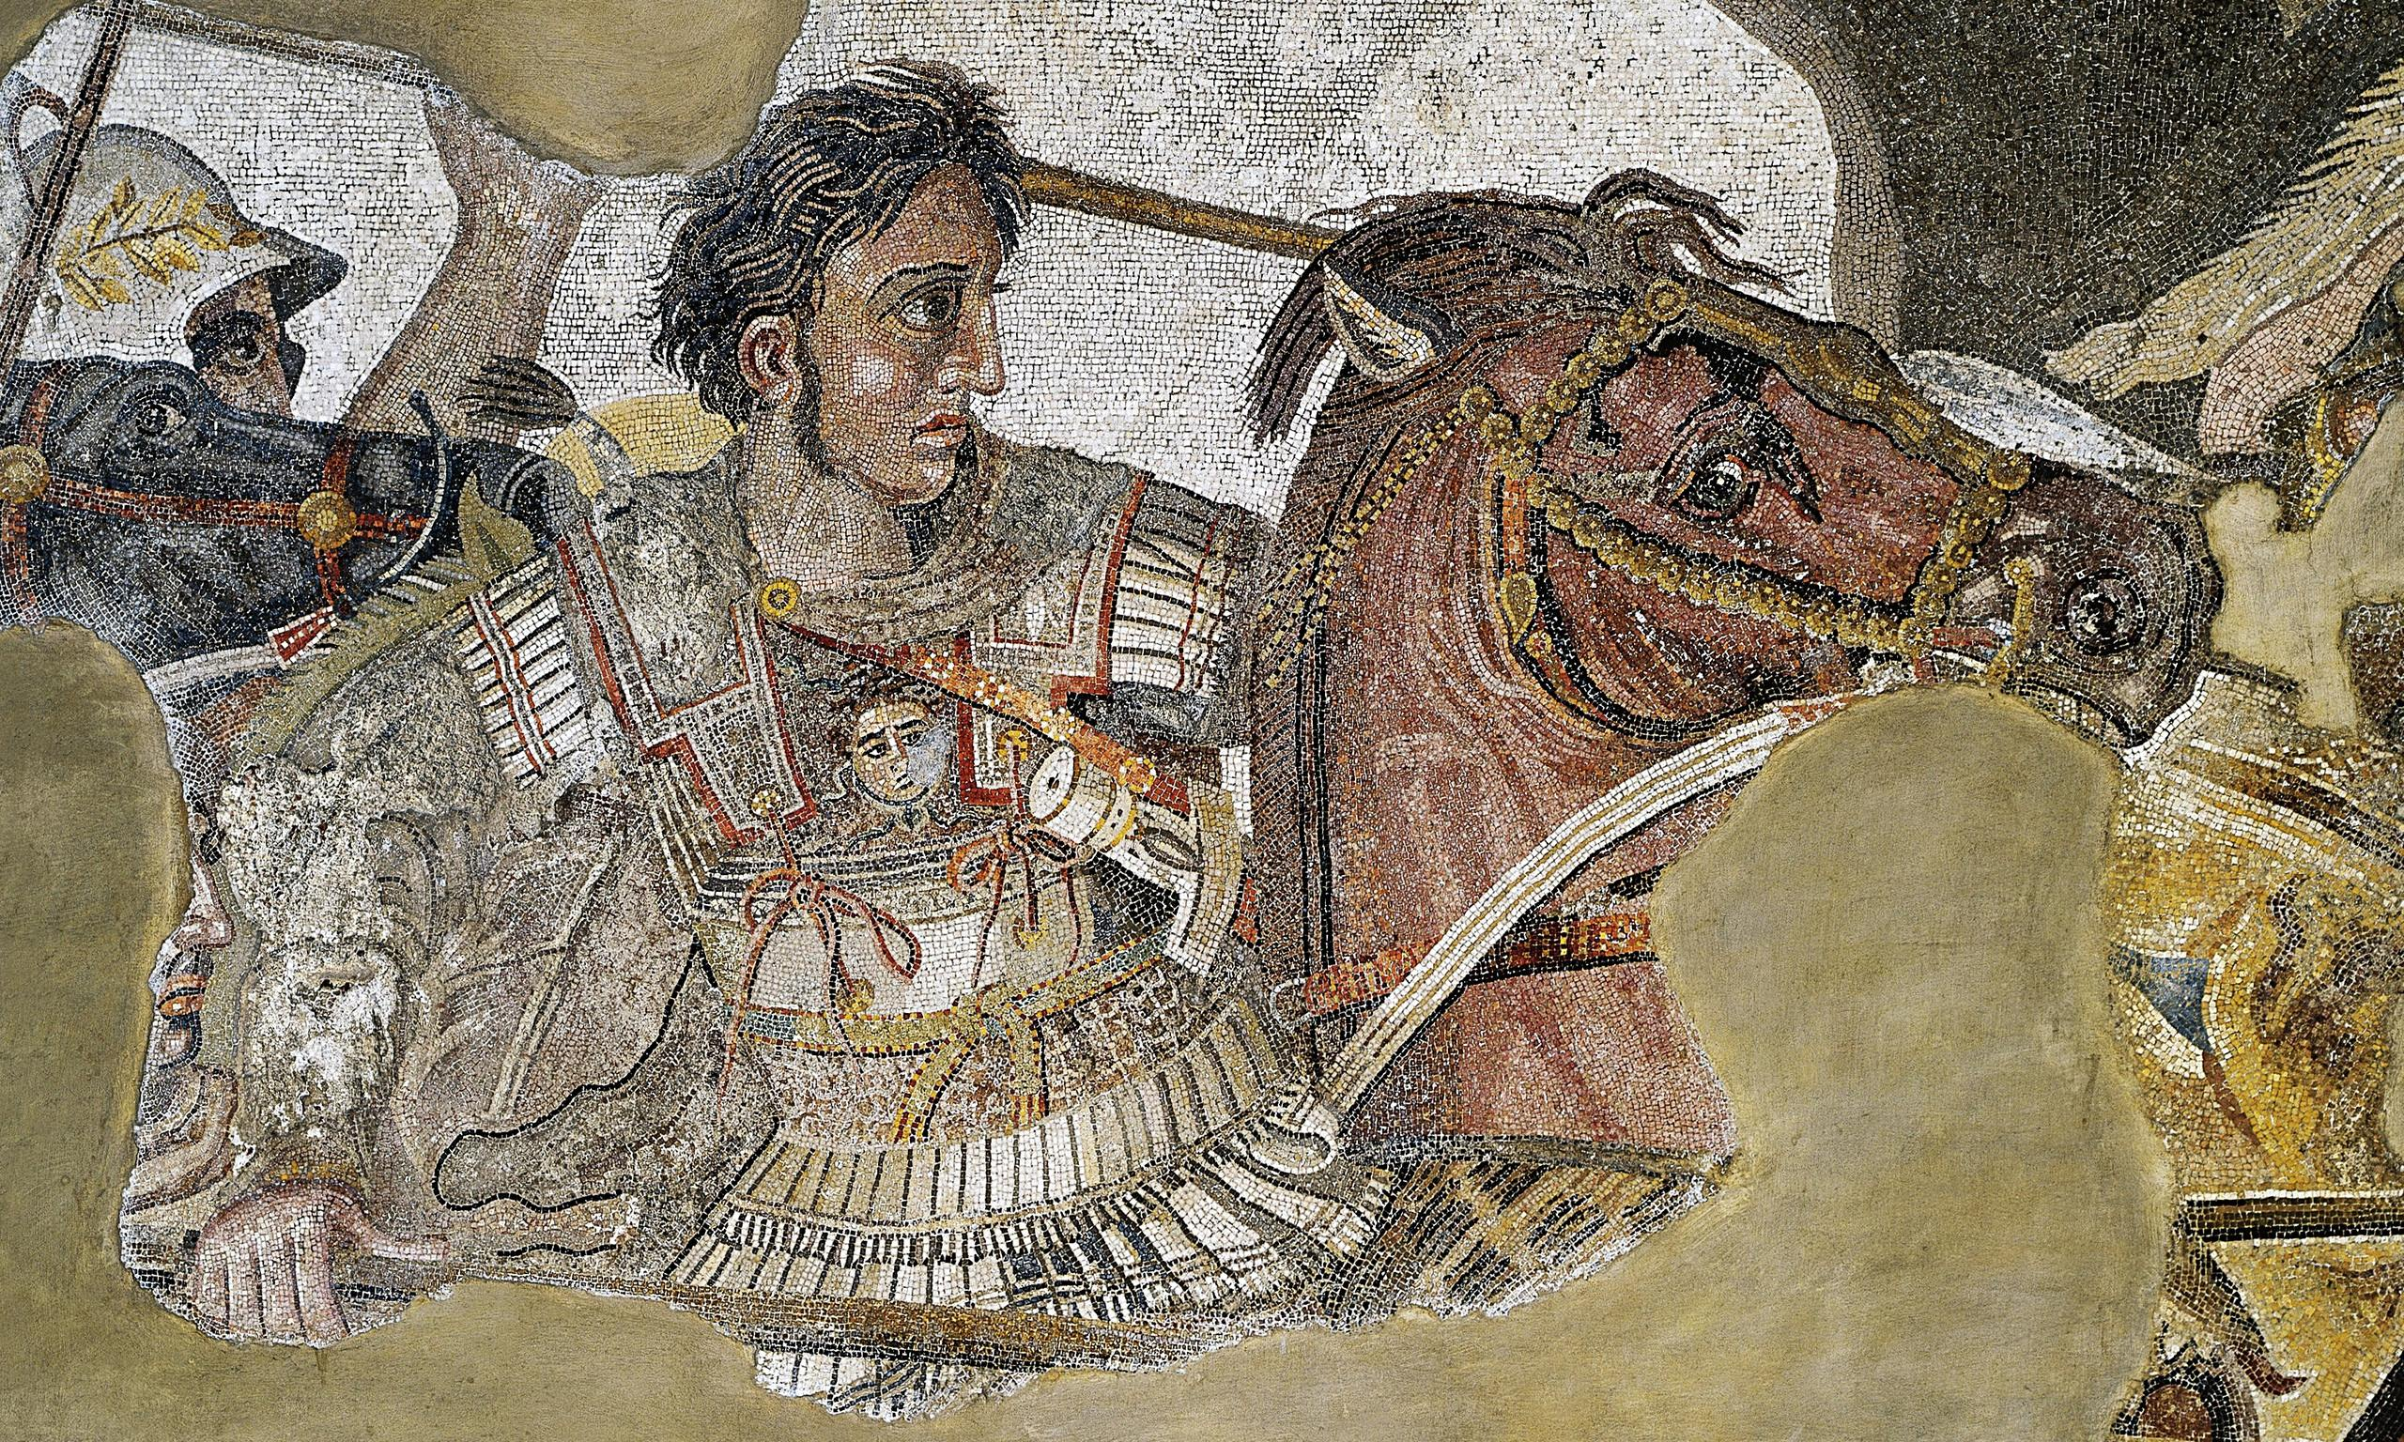
The legacy of Alexander the Great
Goal/s:
Evaluate the legacy of alexander the great
Week 1 Lesson 2 – unit 2
Ms Barrie

Slide 2
What do you already know about Alexander the Great?
Class discussion

Slide 3
Based on what you already know, was Alexander actually ‘Great’?
Class discussion

Slide 4
ACTIVITY 1 – Class Mindmap
Together as a class we will create a mindmap about some of Alexander’s achievements.
You will use this to create an argument – was Alexander a ‘Great leader’ OR just a ‘Power-hungry tyrant’?
Notes:
TEACHER – use ‘Lesson 7 Resource notes’ to create mindmap

Slide 6
ACTIVITY 2 – Evaluate ATG’s legacy
Choose ONE (1) of the following options to evaluate Alexander’s legacy and present an argument. Was Alexander a ‘Great leader’ OR just a ‘Power-hungry tyrant’?
OPTION ONE: Poster | OPTION TWO: Newspaper article | OPTION THREE: Evaluative Paragraph
Create ONE (1) A4 Poster. It must be a propaganda poster with a clear perspective. EITHER: Alexander is a great leader! OR Alexander is a horrible power-hungry tyrant! | Write a newspaper article. It must be a persuasive text with a clear perspective. EITHER: Alexander is a great leader! OR Alexander is a horrible power-hungry tyrant! | Respond to the following statement: ”Alexander was Great” Analyse from both perspectives 1. Alexander WAS a great leader (examples/evidence) 2. Alexander was NOT a great leader (examples/evidence) 3. Make a judgement

